Slide 1
Poem collections
Group 20, CC 2023 Fall, Assignment 1

Slide 2
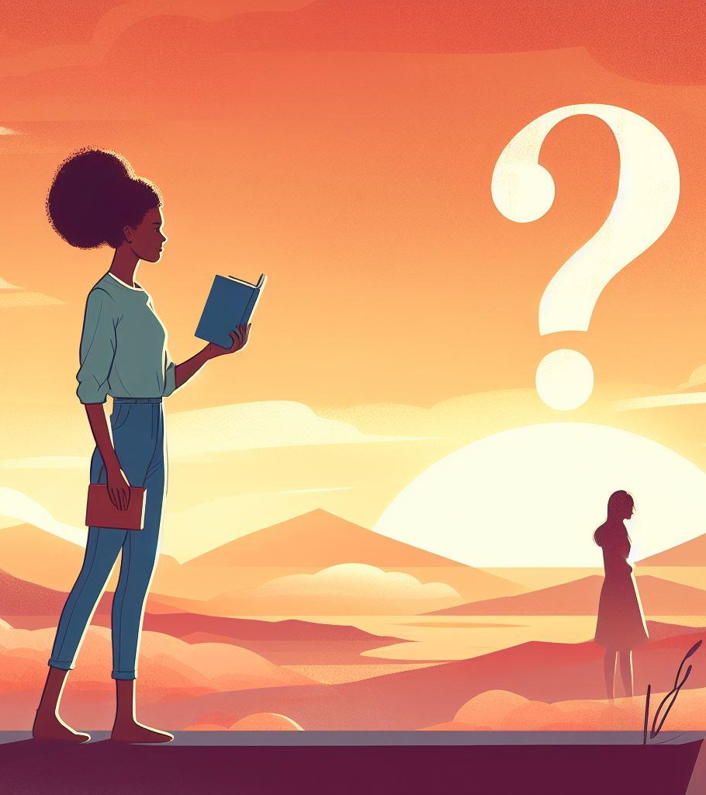

Classical
❓ 👉
📍 👤 👉 🚶‍♂️
🗣️ ❤️ 📚📚 📚
🚫 👩‍🎨
😍 📝 ✍️
😍 📝 👀

Slide 3
Classical
The question is:
Where are you and where are you going?
I've already said that I love many books,
but I was never a poet.
I like poetry,
like writing,
but I just love poetry,
and I just love reading.

Slide 4
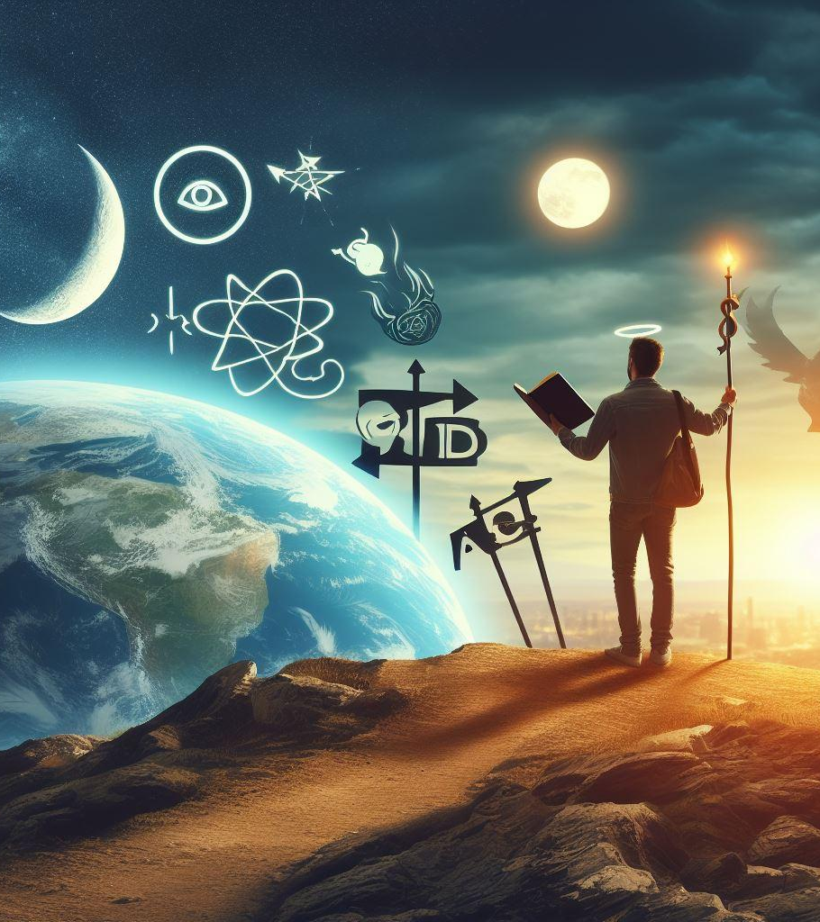
Modern
👀 👤 👉
✝️ 🔬 🤔 🐶 👥
👍 👎 👈 👉
🙏 😍 👈 👉
💯 😎 👈

Slide 5
modern
Why I am a Human Observer?
I am a Christian Scientist, Philosophic, and a Dogmatic Humanist.
I believe there is a difference between good and evil,
a difference between God and a narcissist,
a difference between real and fake.

Slide 6
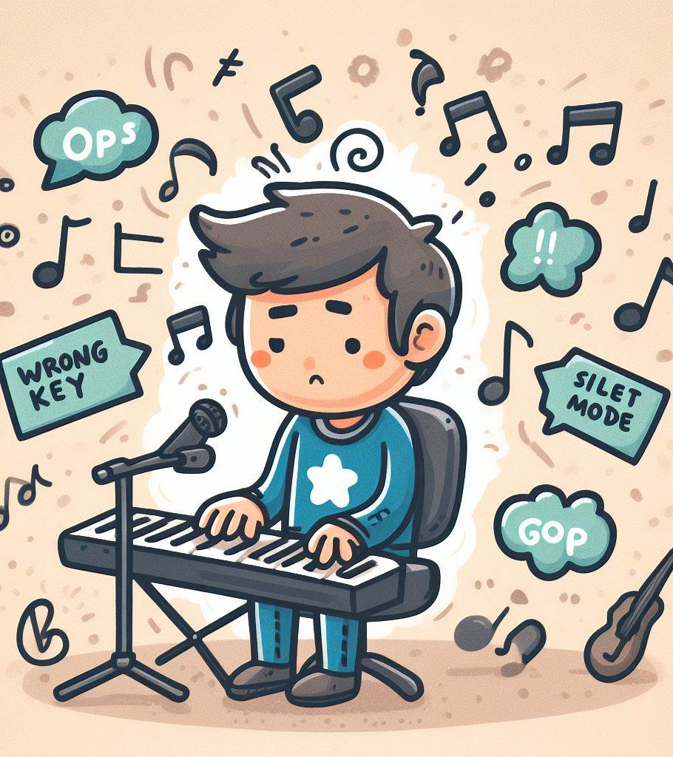
Interesting
👉 🕒 👍
👀 😴 👉
☠️ 📆 👉
🎵 🚫 👉

Slide 7
Interesting
I have a different future,
The next time I'm awake,
It'll be the day before I die,
And I won't be singing anymore.

Slide 8
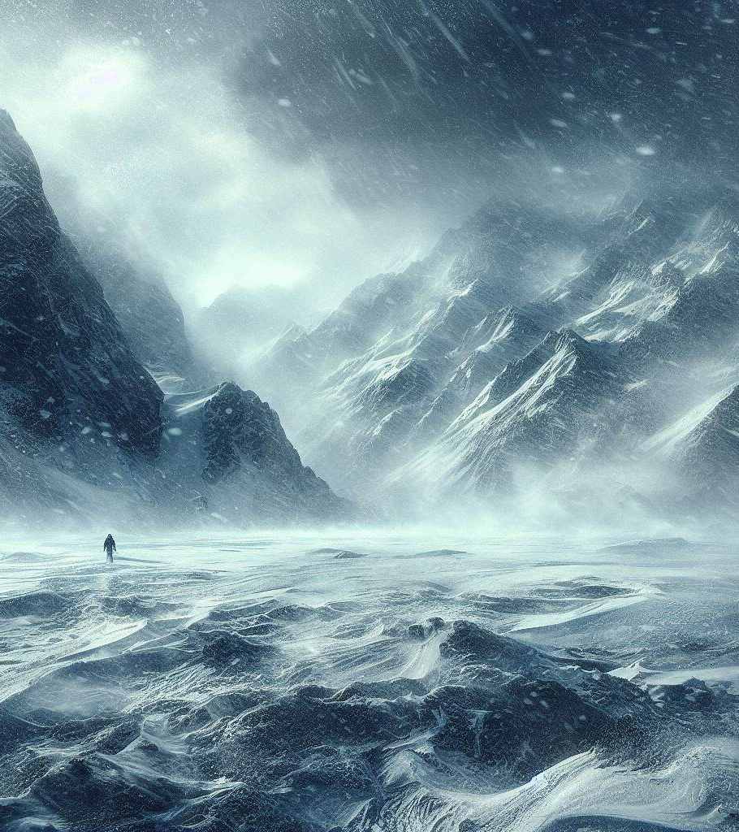
Winter
👉 ❄️ 🚪 👉
❄️ 😴 ❄️ 🌬️ 👉
❄️ 🚫 👉 ❄️ 📚 👉
🤔 👉
❄️ 🚫 👉 ❄️ 📚 👉

Slide 9
Winter
That's why you're right out in the cold.
You're cold because you slept on a blizzard.
So winter is not your first lesson on snow.
Then again,
snow is not your first lesson on snow.

Slide 10
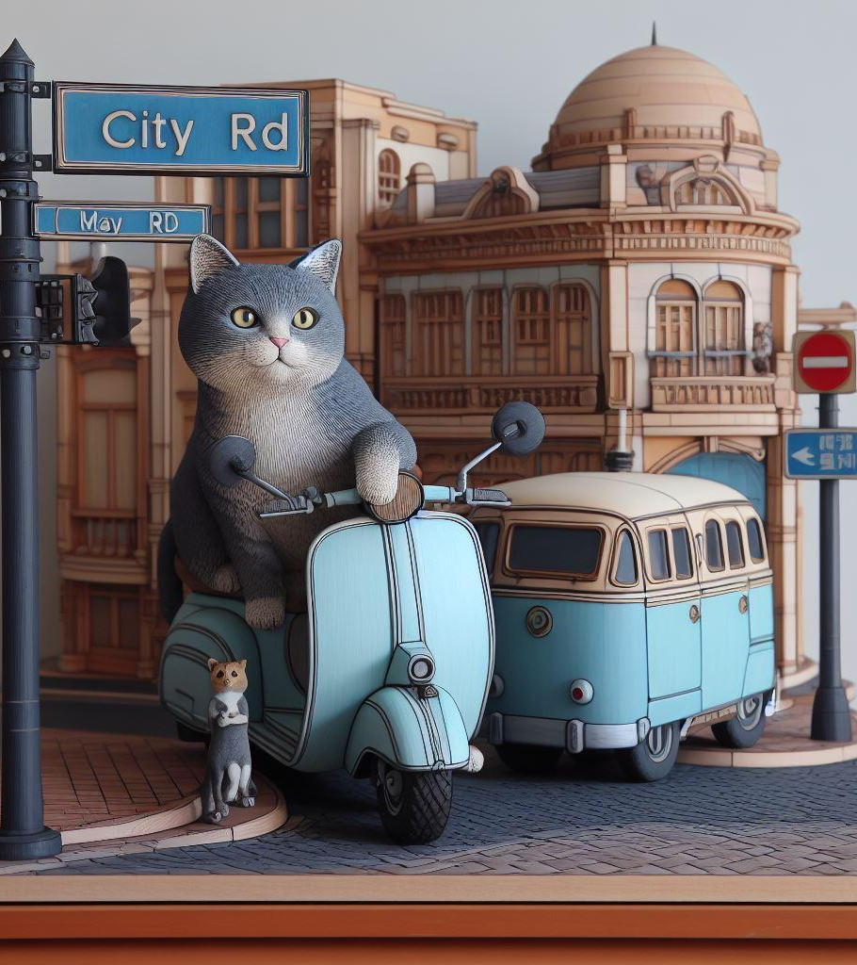
City
🗣️ 👉 🏙️ 👉
🐱 🔵 🐵 👉
🚗 🏙️ 🛣️ 👉
🛣️ 🌼 👉
👍 👉
⬛ 😴 💩 👉
☀️ 😊 👉

Slide 11
City
I'll always call out "town",
like my blue-bellied cat on the corner,
of City Road and May Road.
That's the sense,
of awakening from the black emptiness of The Deep Waste. That morning.

